Slide 1
Theia
Zaid Hamed Ibrahim

Slide 2
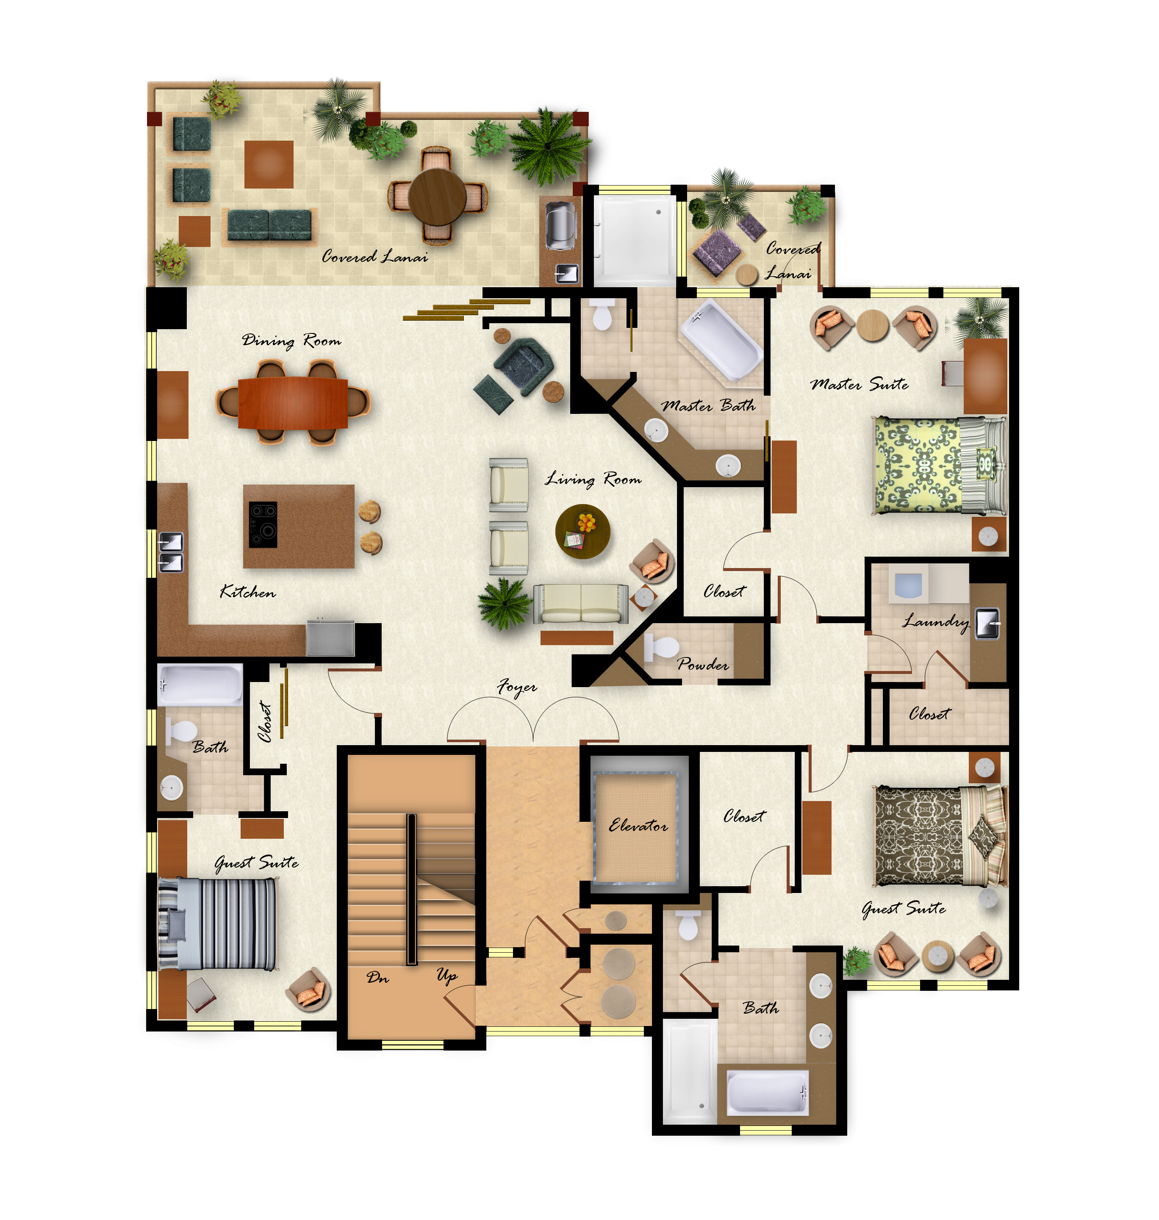
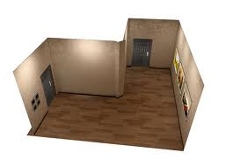
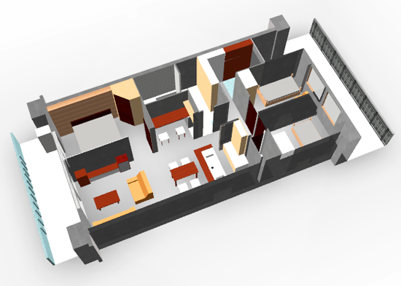
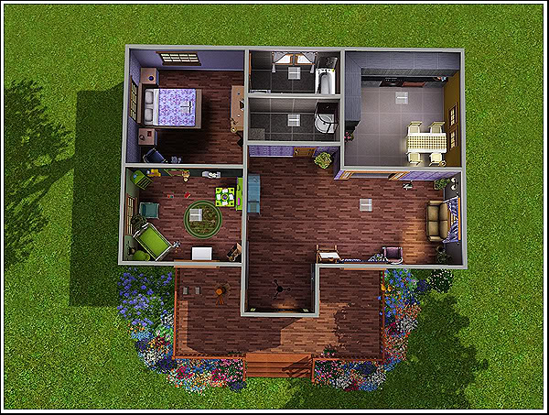
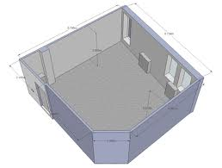
Notes:
Explaining a scenario in which a designer, Kelly, needs to keep track of events and room layouts.

Slide 3
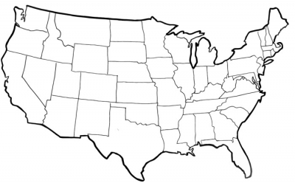
Notes:
Continuing the explanation.
The events may be spread around the country and the designer may be unable to physically view all rooms.

Slide 4
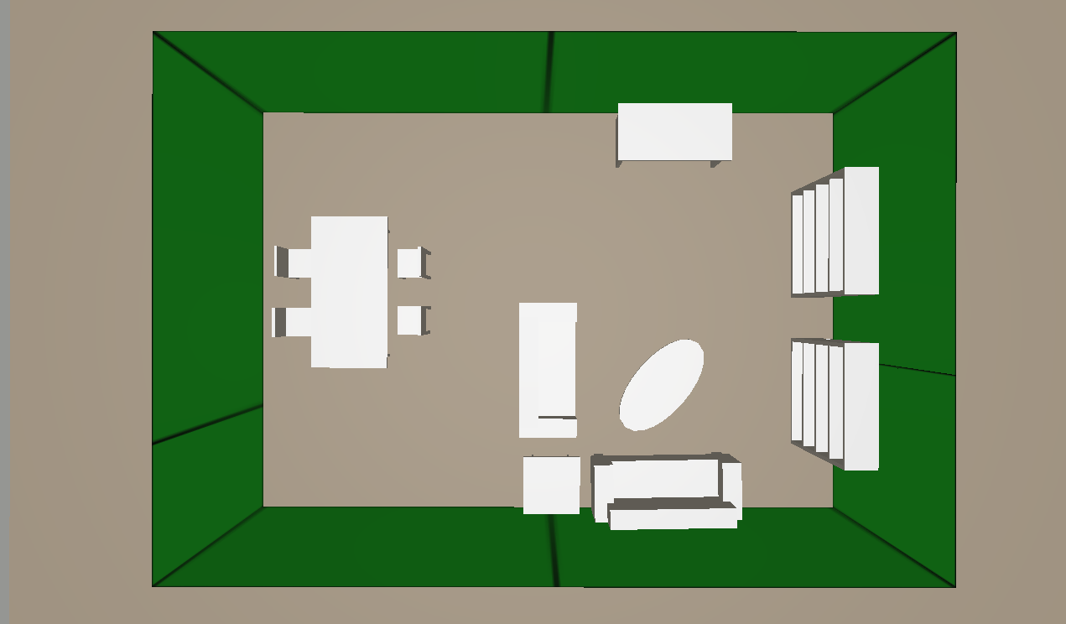
The Problem
How can Kelly keep track of the state of the layout and design of each event?
Notes:
Reiterating the problem and showing a preview image of a room made using Theia
(make this a more attractive room)

Slide 5
The Solution
Notes:
An application that allows you to view the rooms from anywhere.
User-friendly.
Automated, you don’t need to be an architect to design and build a room!
Describing an application that can solve this issue.
Creating a lead-in to Theia.

Slide 6
Theia
A 3D rendering application used to make and share detailed models of any room you choose.
Walk through any room from anywhere and with ease.
Available for anyone with a smart phone.
Notes:
Bringing up Theia and explaining what it is and what it can do.

Slide 7
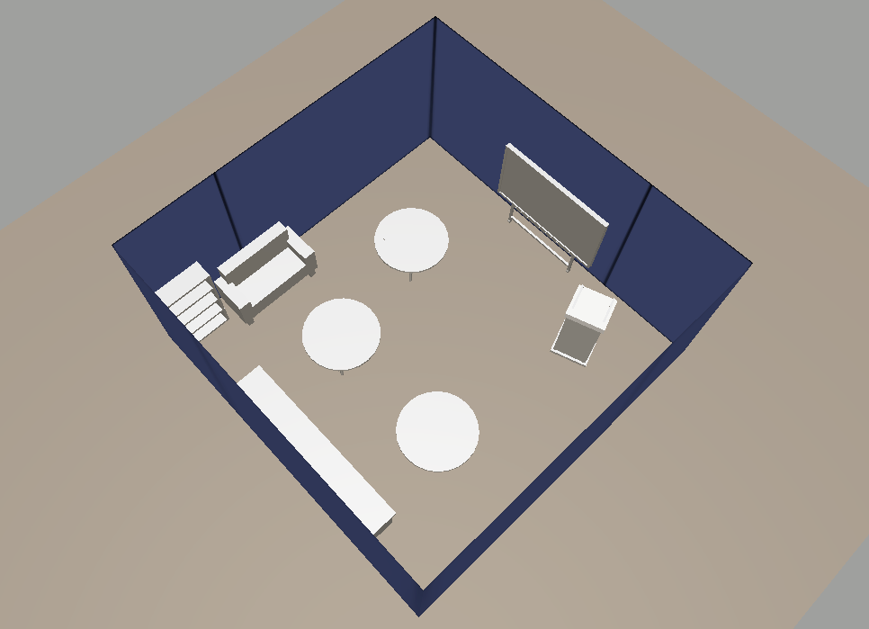
What Makes Theia Different
No need for special cameras or complicated software.
Replicates your room exactly how it should be.
Theia is the public’s room building application.
Competing products:
Notes:
Showing the advantages of Theia and how it is different from other software on the market.
Competing products that use custom cameras

Slide 8
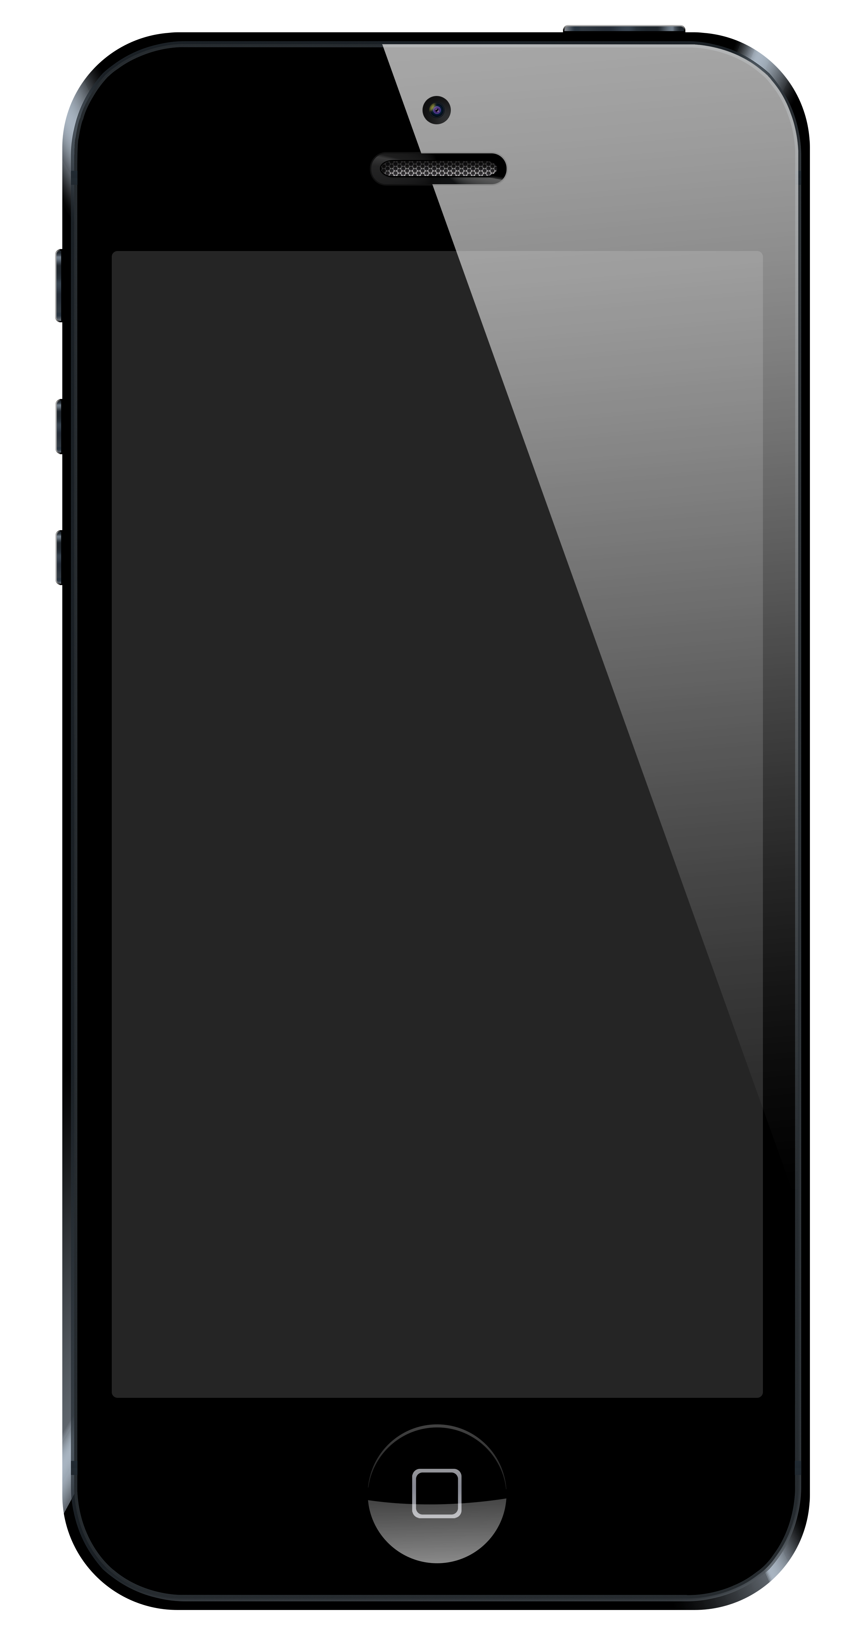
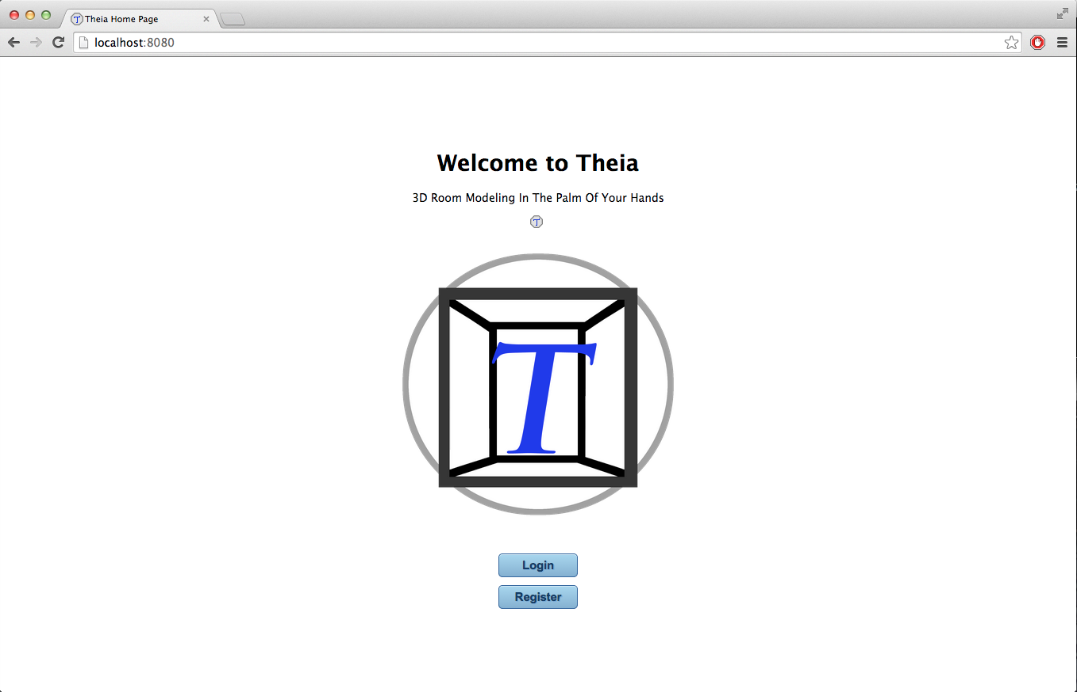
Components of Theia
Notes:
All that's needed for a user is a phone and a browser to build a room!

Slide 9
Demo

Slide 10
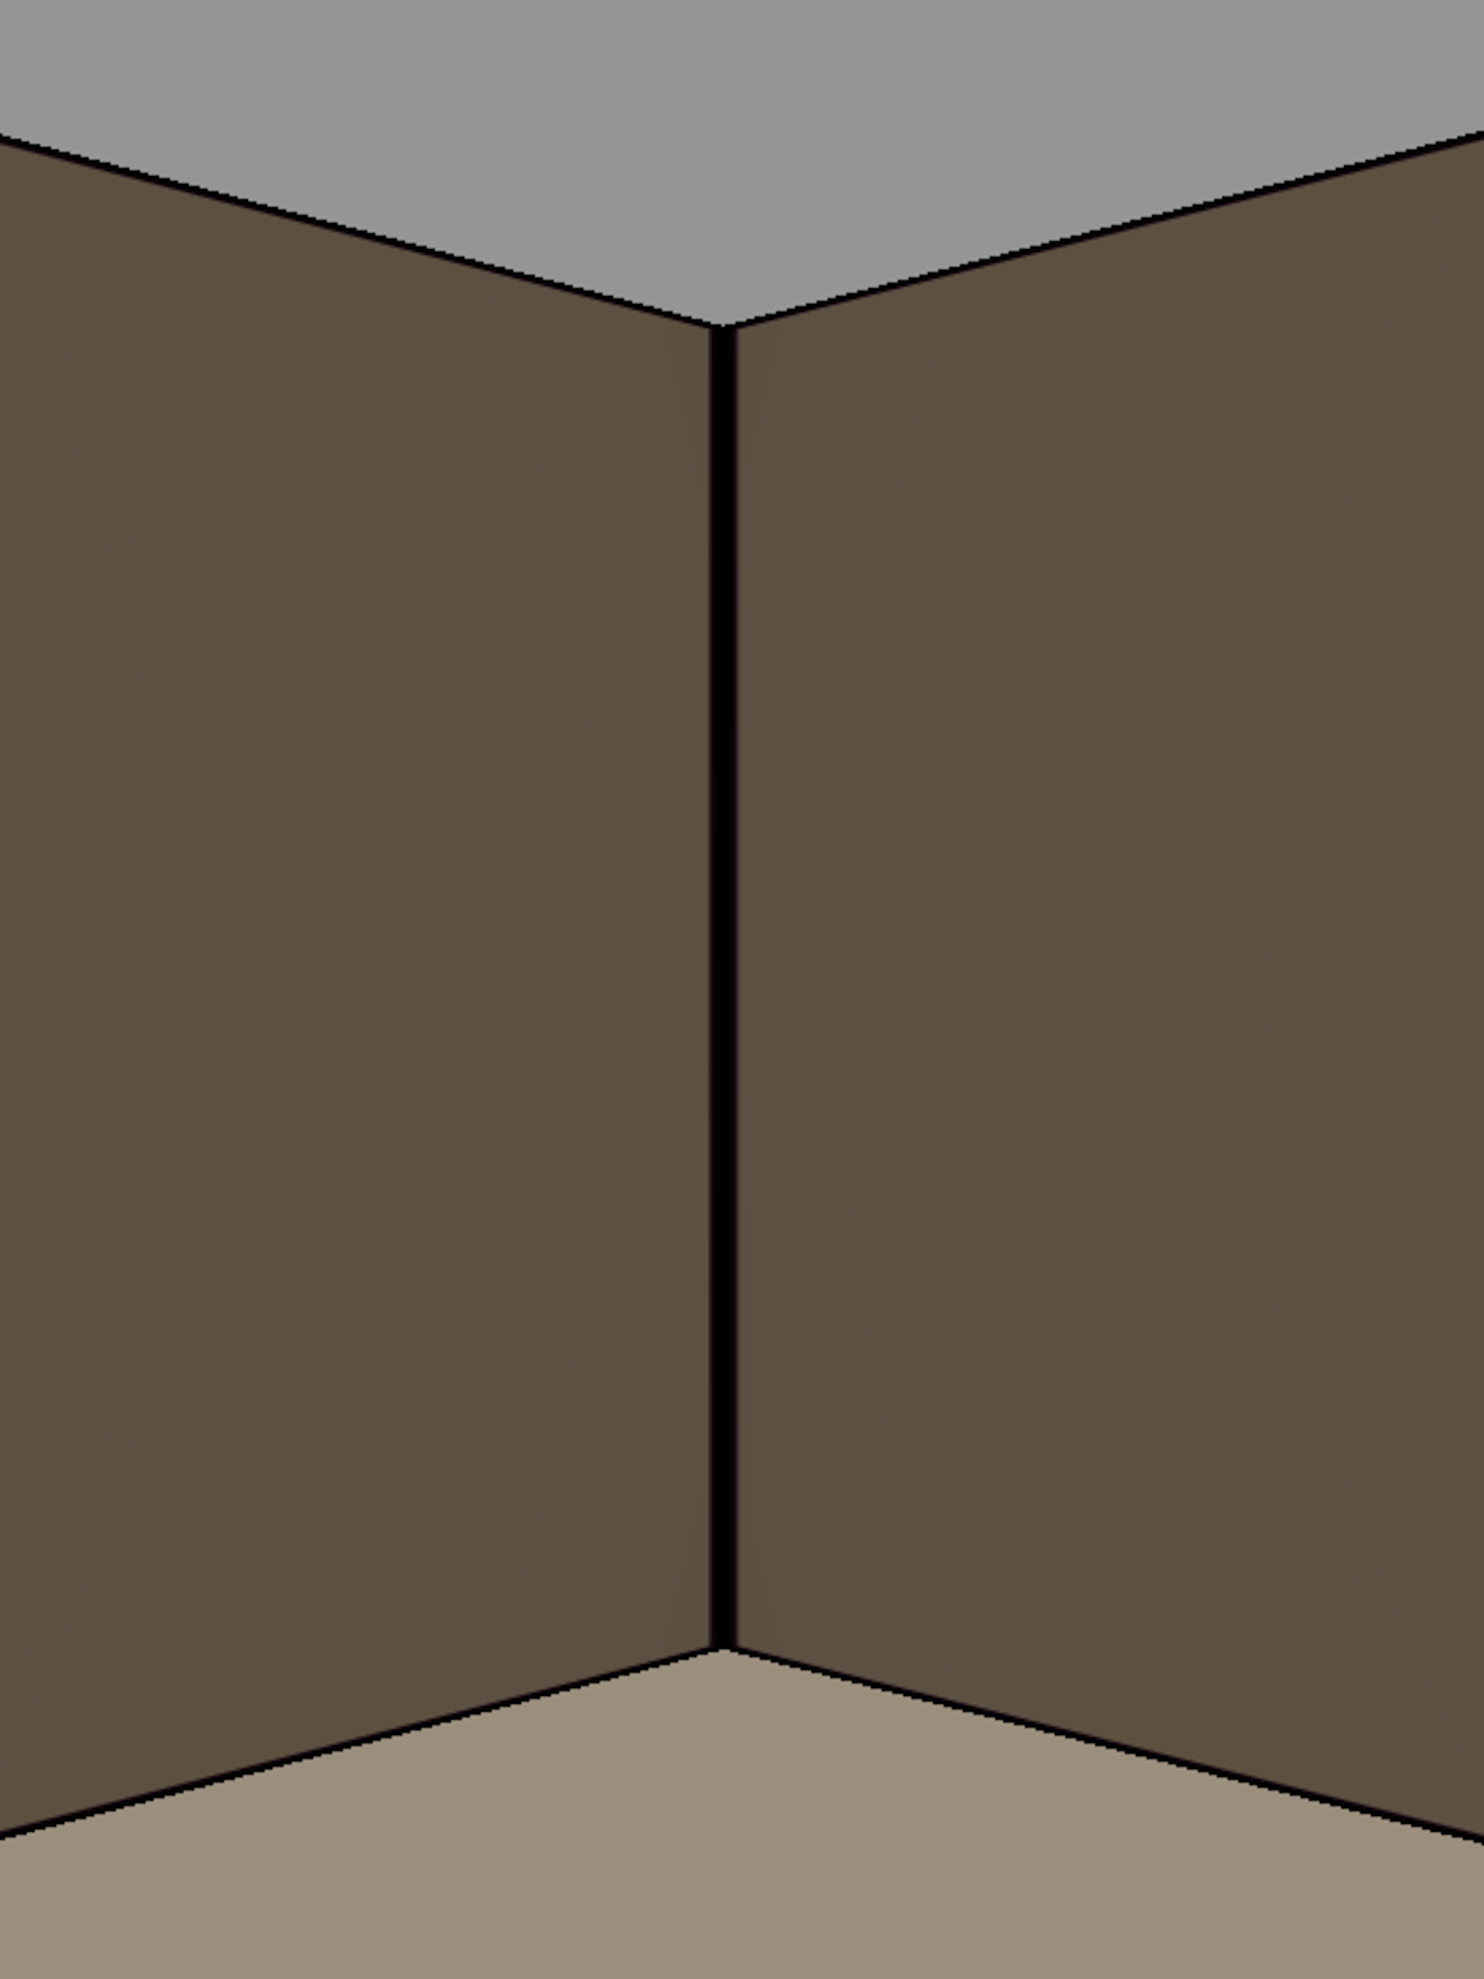
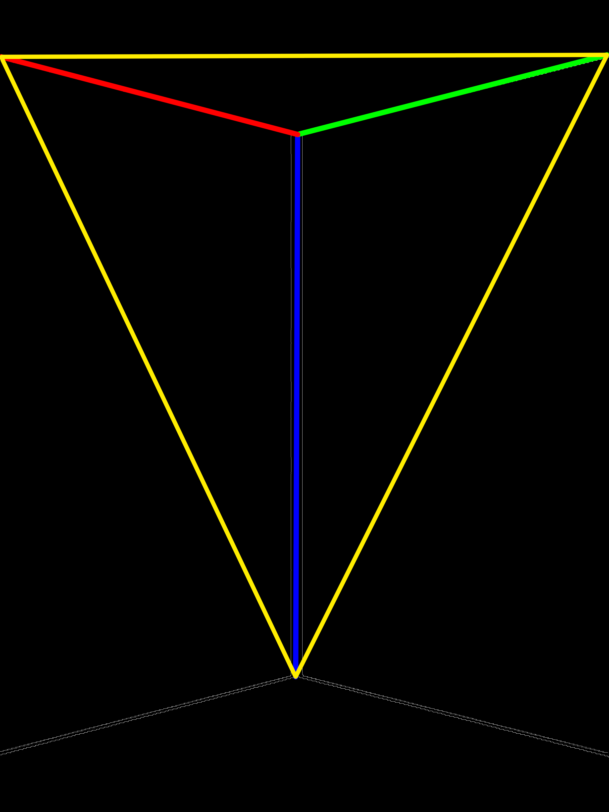
Technical Explanation
Image Scanner
Notes:
Image processing: scanning images for corners
Calculating accurate room dimensions.
Minimizing assumptions
Talk about how to take the picture!
Note: Illustrate the technical challenges instead of showing code and explain how I solved that challenge

Slide 11
Technical Explanation
Room Builder
Notes:
Room Building: placing corners in correct location based on room data.
Adjusting position when lengths are off
Minimizing assumptions when creating a room.

Slide 12
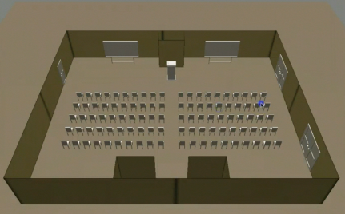
Notes:
Mention these points!
Theia is a 3D rendering application used to scan images and share detailed models of a room.
Theia allows the user to input objects and design the layout of the selected room.
Theia is the public’s room building application.

