Slide 1
Constant Gardener
100% Demo
Sam Lightbody

Slide 2
What is Constant Gardner?
Server focused security tool
Protects computers from privilege escalation attacks
Makes use of the DynamoRIO API to do this

Slide 3
Motivation
Privilege escalation made up seven out of the top ten most frequent attacks in Q1 2010
The ten most active malware families ALL use escalation vulnerabilities

Slide 4
How Does It Work?
Builds a profile of how the program you want to protect should act
Anytime the program performs certain actions it verifies those actions against the profile
Based on this the action is either allowed, or the program is halted

Slide 5
How Does It Work?

Slide 6
Example

Slide 7
Example Cont.
Notes:
Must build a control flow graph of the target binary
The control flow graph must be accessible indefinitely and protected from memory corruption or overwrite attacks

Slide 8
Example Cont.
Notes:
Must build a control flow graph of the target binary
The control flow graph must be accessible indefinitely and protected from memory corruption or overwrite attacks

Slide 9
Example Cont.
Notes:
Must build a control flow graph of the target binary
The control flow graph must be accessible indefinitely and protected from memory corruption or overwrite attacks

Slide 10
Example Cont.
Notes:
Must build a control flow graph of the target binary
The control flow graph must be accessible indefinitely and protected from memory corruption or overwrite attacks

Slide 11
Example Cont.
Notes:
Must build a control flow graph of the target binary
The control flow graph must be accessible indefinitely and protected from memory corruption or overwrite attacks

Slide 12
Example Cont.
Notes:
Must build a control flow graph of the target binary
The control flow graph must be accessible indefinitely and protected from memory corruption or overwrite attacks

Slide 13
Example Cont.
Notes:
Must build a control flow graph of the target binary
The control flow graph must be accessible indefinitely and protected from memory corruption or overwrite attacks

Slide 14
SSH

Slide 15
Demo

Slide 16
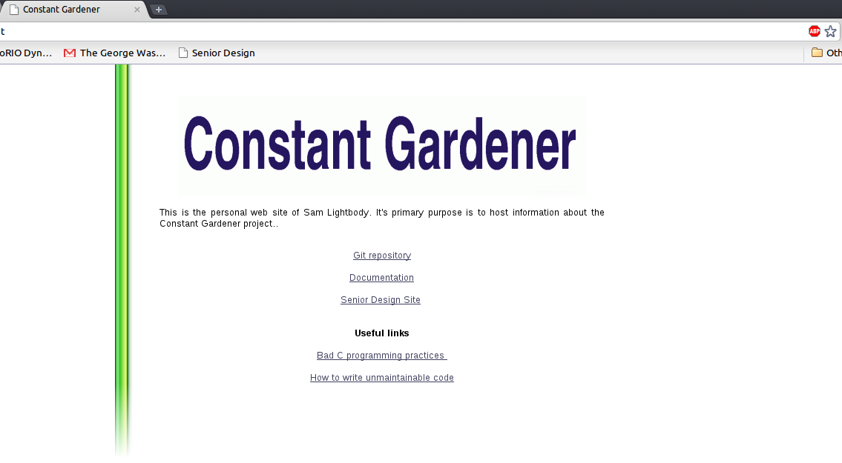
Challenges
High Level

Slide 17
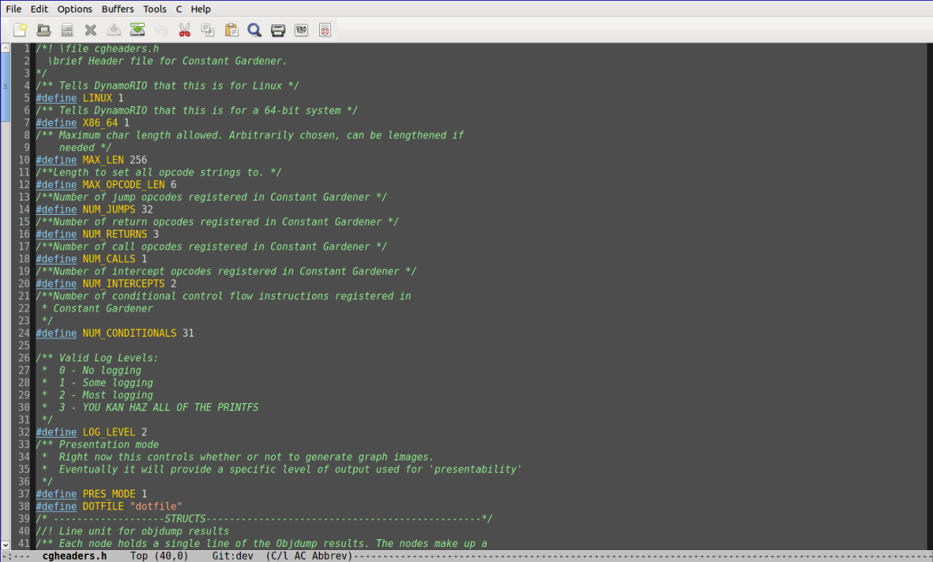
Challenges
Medium Level

Slide 18
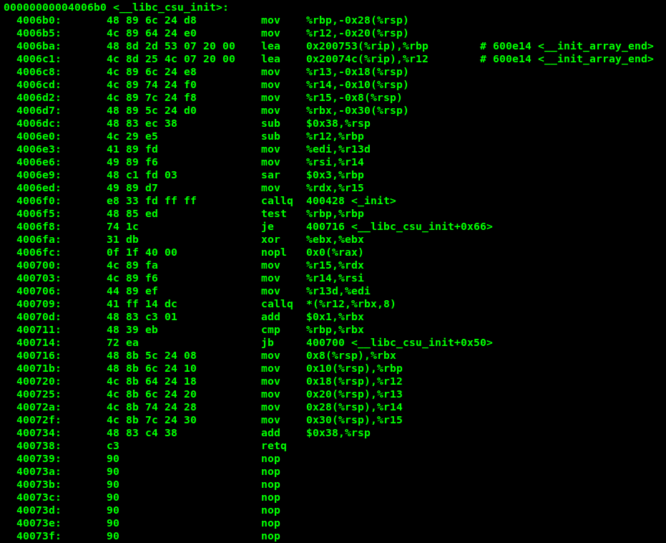
Challenges
Low Level

Slide 19
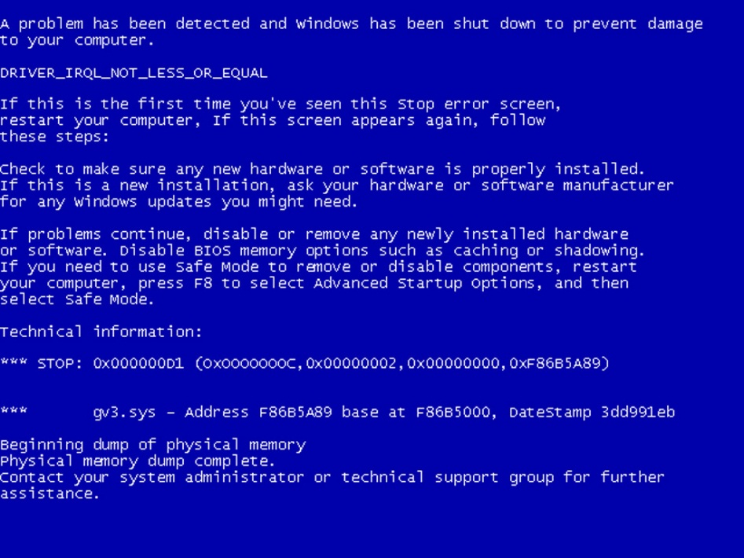
Challenges
Low level complexity leads to

Slide 20
Final Thoughts
Constant Gardener successfully protects against certain extremely prevalent attacks
It does this by working on a very low-level to observe behavior
Moving forward I’d like to focus on improving efficiency and user friendliness

Slide 21
Questions?

