Slide 1
P101
Terrence Lewis
Notes:
Fear plays a large role in our lives, its something that we have to get over but it can be quite limiting

Slide 2
Number one fear of Americans ?

Slide 3
What makes a good presentation ?

Slide 4
Presenting Facts
In as little as 15 seconds listeners will judge a presenter’s creditably based solely off of their voice and personal characteristics (DeVito 148)
Most frequent problems in ruining a presentation includes:
A presenter’s lack of dynamism, incoherent speech and the use of filler words.
Problems of body fluidity and body language i.e. a lack of eye contact, bad posture, or bad use of hand gestures.

Slide 5
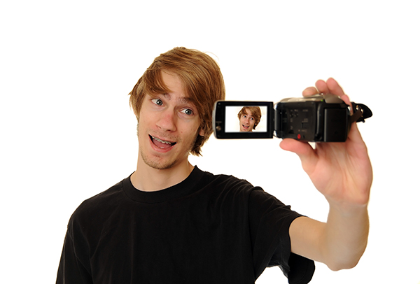
Possible Fixes

Slide 6
Solution
Presenting 101 (P101)
Making presentations great
Notes:
Detail how it is a solution

Slide 9
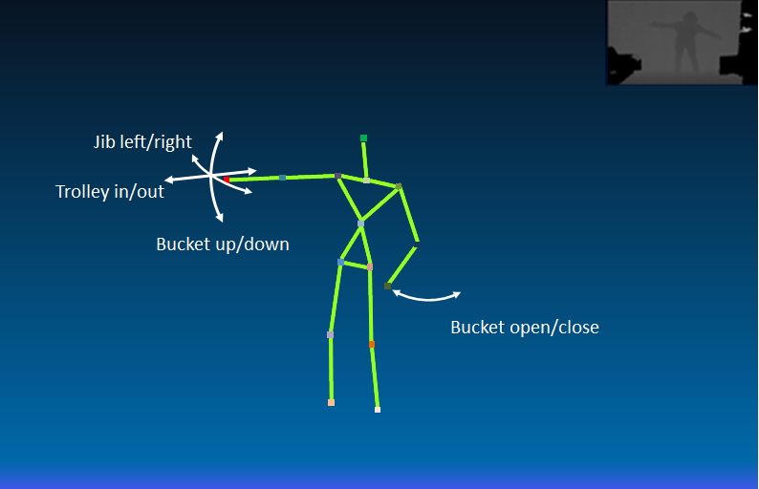
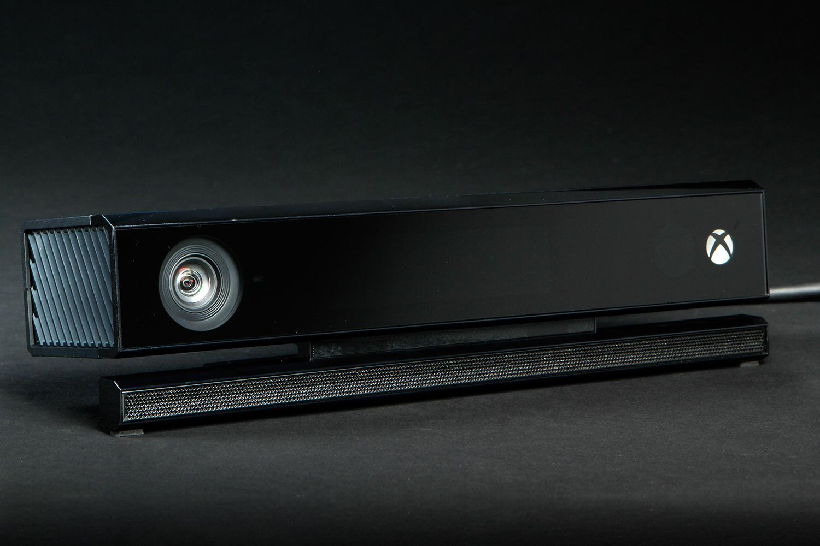
P101 Details - Visual
Notes:
Using the Kinect’s tracking capabilities, we are able to watch for things like pacing, hand gestures and posture (like swaying or leaning)
Using another program concurrently we are also able to listen for volume, pitch, rhythm, and bad words

Slide 10
P101 Details - Visual

Slide 11
P101 Details - Audio

Slide 12
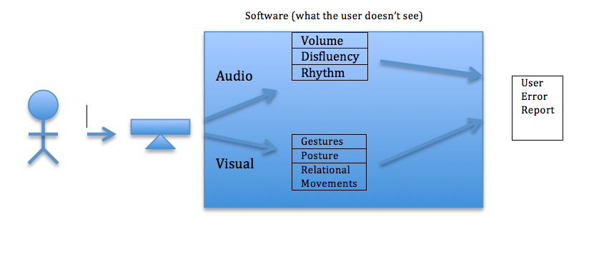
User interaction & Processing the data

Slide 13
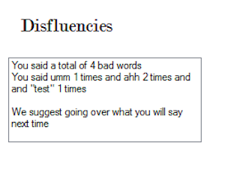

Slide 14
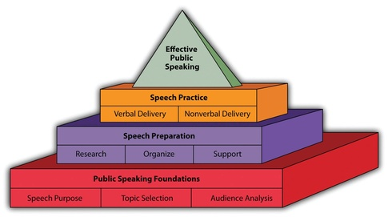
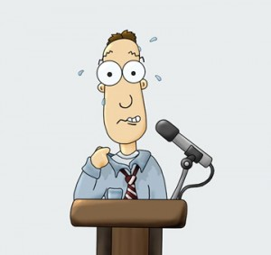
Results
Notes:
P101 users get the preparation and practice that they need
Users get the added confidence of being able to successfully deliver a presentation
Exudes characteristics of a creditable speaker
Allows audience members to be more receptive and helps you get your message across.

Slide 15
References
http://www.american.edu/soc/faculty/upload/Palmer-Presentation-Workshop-Problems.pdf
DeVito, Joseph A. The Interpersonal Communication Book. New York, NY: HarperCollins College, 1995. Print 148.

