Slide 1
CAPITAL Passages and reMind
Katie Stasaski and Elsbeth Turcan

Slide 2
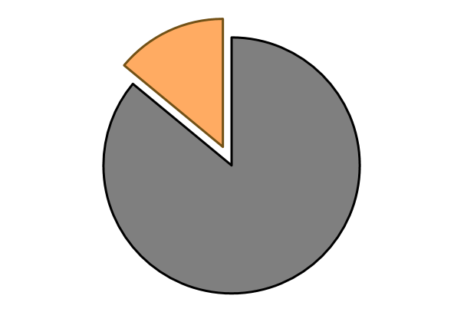
Ravrocak
Carsoem rassark vesr usrark su seqa
Tra raqarkad orvrobas.
I koda mu sioromsaak ok su vros verr
I kesrs roqa sussam sra
Xomsr sromkroseum vrums voae ruimd
Kukauma vru
14%
Tyunerr mar

Slide 3
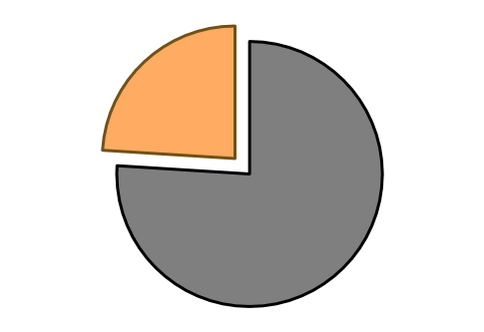
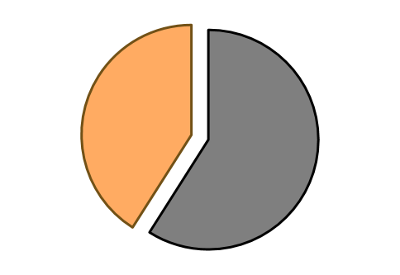
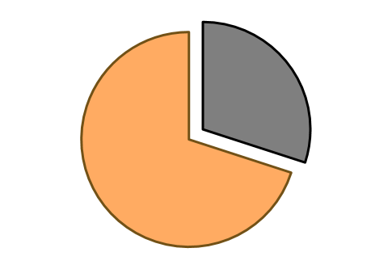
How Prevalent is Adult Illiteracy?
24%
14%
of black U.S. adults
of U.S. adults
of incarcerated U.S. adults
41%
of Hispanic U.S. adults
70%
Notes:
14% of the U.S. population is 29 million people. 19% of high school graduates can’t read, and these statistics haven’t changed significantly in 10 years.

Slide 4
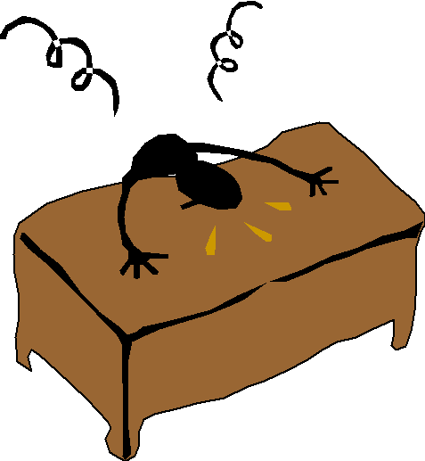
Current Instructor Problems
Notes:
Focus on frust don’t make it just about time.Relax on this slide.
After demo: say these were problems, instructors now spend 5 min and students have 100 hours of exercises to do.
Note: the frustrations are supposed to be: time-consuming, craft questions by hand, and I couldn’t think of another one so it’s just general difficulty.
The solutions should be more free time (listen, I’m using Microsoft Clipart 2.0 basically; we don’t have quality images to pick from that I can find--this was sort of like relaxing, I guess), “automatically generated questions” (this one was weird but I figured idk it was a little like you just get the questions off the server, so like a server tower….), and general happiness.

Slide 5
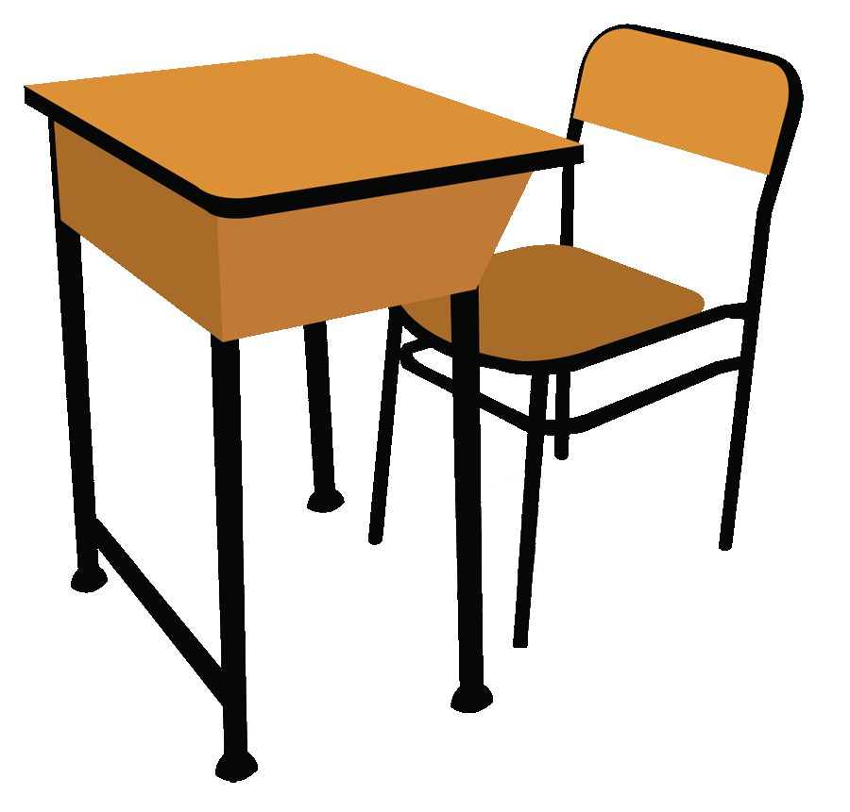
Current Student Problems
Notes:
Want to show studying and frustration.

Slide 6
CAPITAL
Comprehension and Pronunciation
Instructional Tools for Adult Learners

Slide 7
Overall System
“TEKST”
Algorithm
Generates Questions
“TEKST”
Algorithm
Generates Questions
Passage Sent
Passage Sent
Questions Sent To
CAPITAL Passages Module
CAPITAL Passages Module
reMind Student Mobile App
reMind Instructor Website
Student Responses
reMind Instructor Website
Notes:
Font too small. Don’t have to write out tekst. THink about pics.

Slide 8
Notes:
TODO: Tell this demo through pictures

Slide 9
Overall System
“TEKST”
Algorithm
Generates Questions
Passage Sent
Questions Sent To
CAPITAL Passages Module
reMind Student Mobile App
reMind Student Mobile App
reMind Instructor Website
Student Responses
Notes:
Font too small. Don’t have to write out tekst. THink about pics.

Slide 10
Notes:
TODO: Film new demo

Slide 11
Overall System
“TEKST”
Algorithm
Generates Questions
“TEKST”
Algorithm
Generates Questions
Passage Sent
Questions Sent To
CAPITAL Passages Module
reMind Student Mobile App
reMind Instructor Website
Student Responses
Notes:
Font too small. Don’t have to write out tekst. THink about pics.

Slide 12
Question Generation Using “TEKST” Algorithm
Subject | Facts
John | Saw Sam | Went Running | Traveled to China
Mary | Went Home | Saw a Movie
Roy | Is Feeling Sick | Saw a Movie
Steve | Went to Class | Is a Baseball Player | Enjoys Fashion
Passage
Fact Extraction
Fact Matrix
...John saw Sam at the garden on Saturday night...
Subject: John
Verb: saw
Object: Sam
Attribute: at
the garden
Attribute: on Saturday night
Notes:
Make a fact matrix- make the actual matrix!

Slide 13
Question Generation Using “TEKST” Algorithm
Passage
Fact Extraction
Fact Matrix
Question Rules
Distractor Generator
Finished Question
...John saw Sam at the garden on Saturday night...
Subject: John
Verb: saw
Object: Sam
Attribute: at
the garden
Attribute: on Saturday night
Subject | Facts
John | Saw Sam
Mary | Went Home | Saw a Movie
Who saw Sam at the garden?
When did John see Sam at the garden?
John
Mary
Roy
.
.
.
Who saw Sam at the garden?
-John
-Mary
-Roy
-Tim
Notes:
Make a fact matrix- make the actual matrix!

Slide 14
Complex Question Generation
Saw Sam at the garden
Subject | Facts
John | Saw Sam | Went Running | Traveled to China
Mary | Went Home | Saw a Movie
Roy | Is Feeling Sick | Saw a Movie
Steve | Went to Class | Is a Baseball Player | Enjoys Fashion
Traveled to China
Which of the following did John not do?
Saw a Movie
Went Running
Notes:
Make a fact matrix- make the actual matrix!

Slide 15
Complex Question Generation
Subject | Facts
John | Saw Sam | Went Running | Traveled to China
Mary | Went Home | Saw a Movie
Roy | Is Feeling Sick | Saw a Movie
Steve | Went to Class | Is a Baseball Player | Enjoys Fashion
John
Who saw a movie and was feeling sick?
Mary
Roy
Steve
Notes:
Generates questions like "Who did x and y"
Chooses three actors who did not do both x and y as distractors.
Probability increases if other actors did only x or only y.

Slide 16
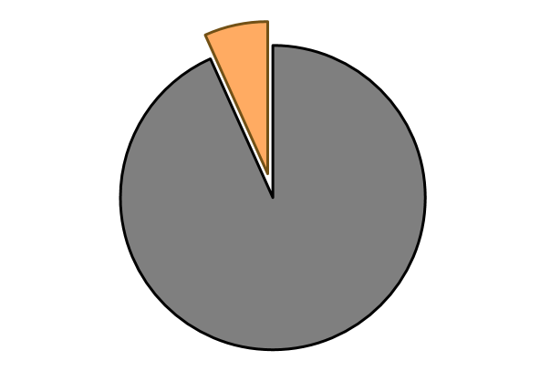
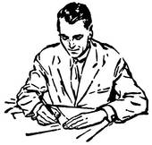
Our Future with CAPITAL
15,000,000
Notes:
TODO: impact it back to washlit too -- if possible, maybe have some pictures show up in a ring around the chart? Could use clipart if we can’t go to washlit eventually
TODO : lengthen student demo, shorten instructor one.
15,000,000 is a very high estimate of the number of people we can help--14% of the adult population can’t read, and 52% of Americans with less than a high school education have smartphones. Not all illiterate adults need have less than a high school education, and it’s possible the two statistics do not refer to the exact same age groups, etc., but in general we should be able to help about half of those 29 million adults who currently are illiterate.

