Slide 1
Investor PAL
Doug Dellolio

Slide 2
“ . . .analyze trends in press releases and tweets to determine the movement of a stock”

Slide 3
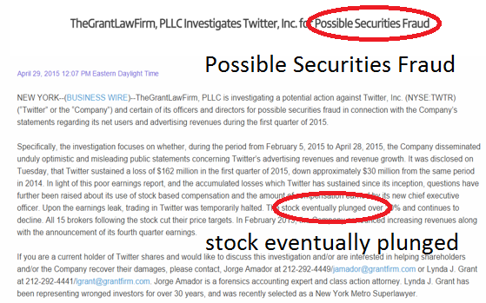
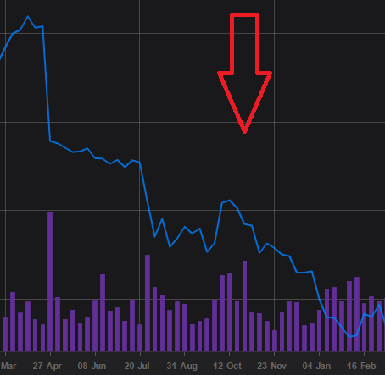
Twitter Inc. (TWTR)

Slide 4
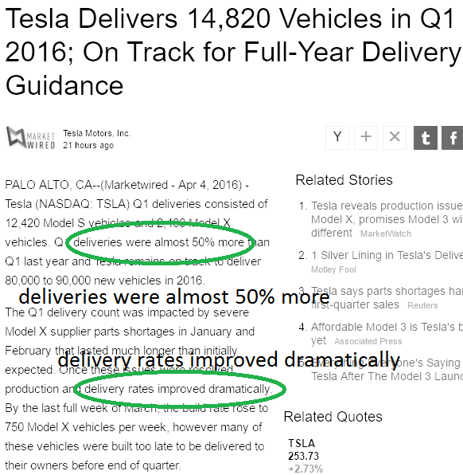
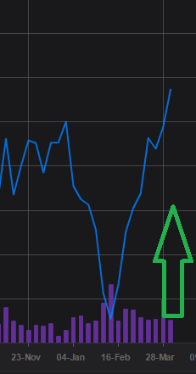
Tesla (TSLA)

Slide 7
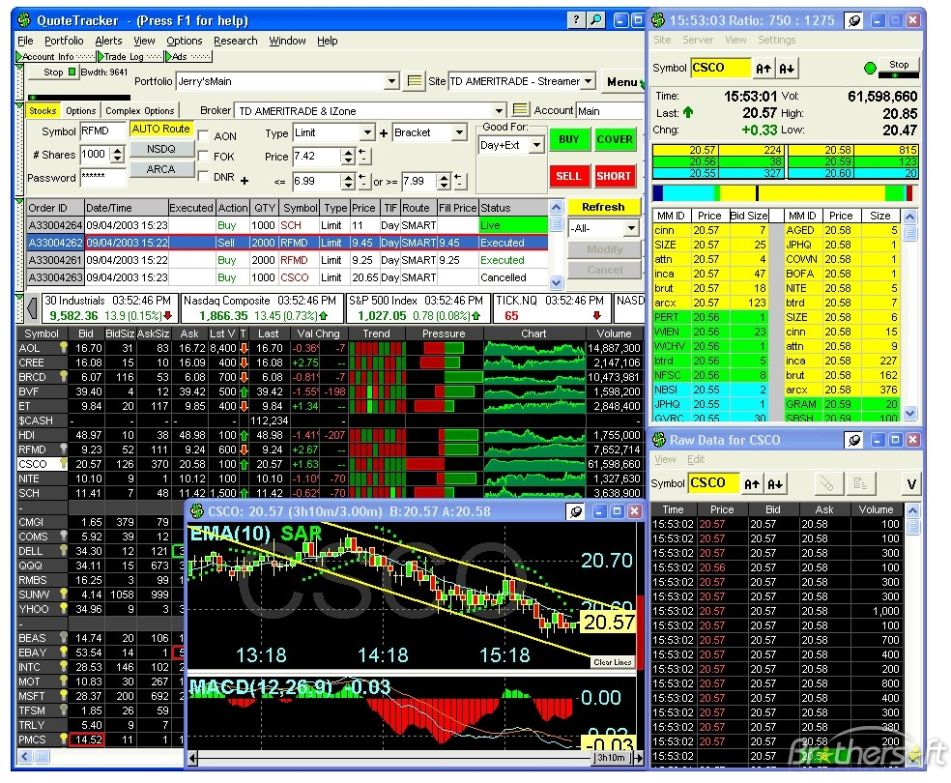

Slide 8
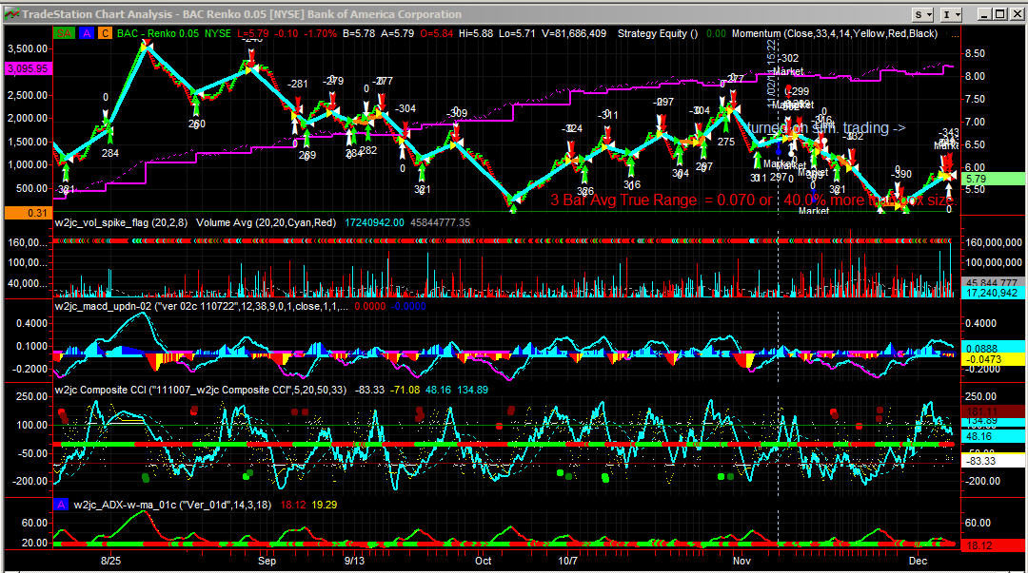

Slide 12
Challenges

Slide 13
Finding Proper Libraries for NLP

Slide 14
Corresponding words with movement

Slide 15
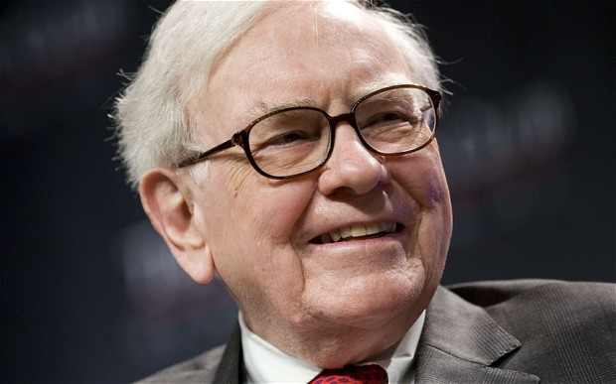
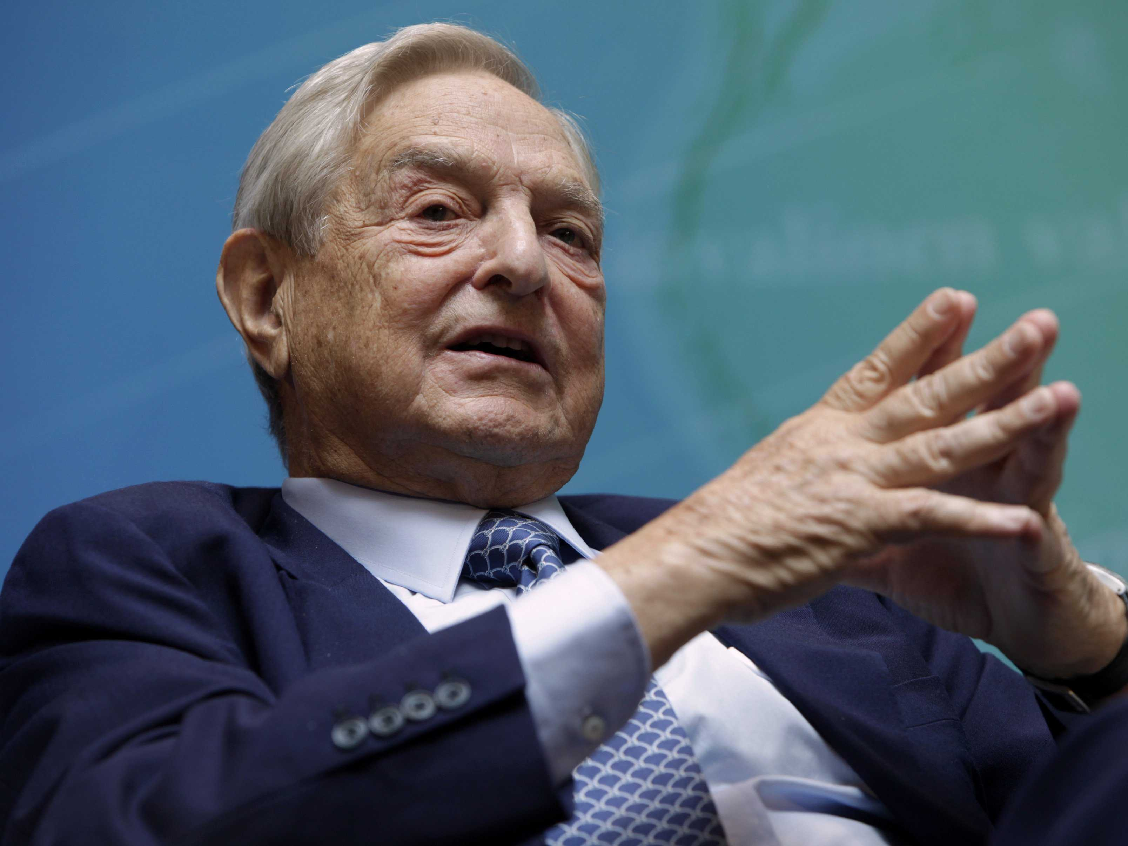
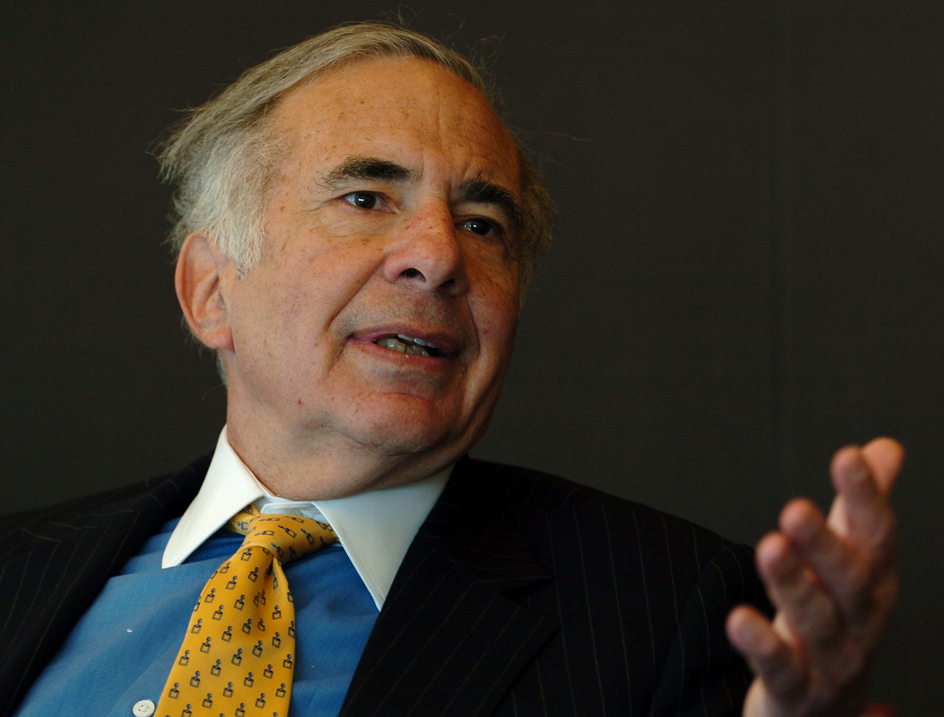
Warren Buffett
$66.7 Billion
George Soros
$23 Billion
Carl Icahn
$21.3 Billion

Slide 16
Investor PAL + You = $$?

