Slide 1
R. Links SensorPack
MATT SCAPEROTH
Notes:
Introduction
Explore idea of what it takes to build a robot: Motivation for project
What is it?
Components
General plan

Slide 2
The landscape of robotics is changing
Notes:
Motioncapture
Goal for motioncapture
Example image of pointcloud
What the pointcloud is
Pointcloud to heightmap
Heightmap comparison
What the heightmap will be used for
Where the heightmap comes from

Slide 3
R. Links robot
Created by Sam Zapolsky at GWU

Slide 4
SensorPack Open Source Library
Sensor Integration
Orientation Correction
Heightmap Creation

Slide 5
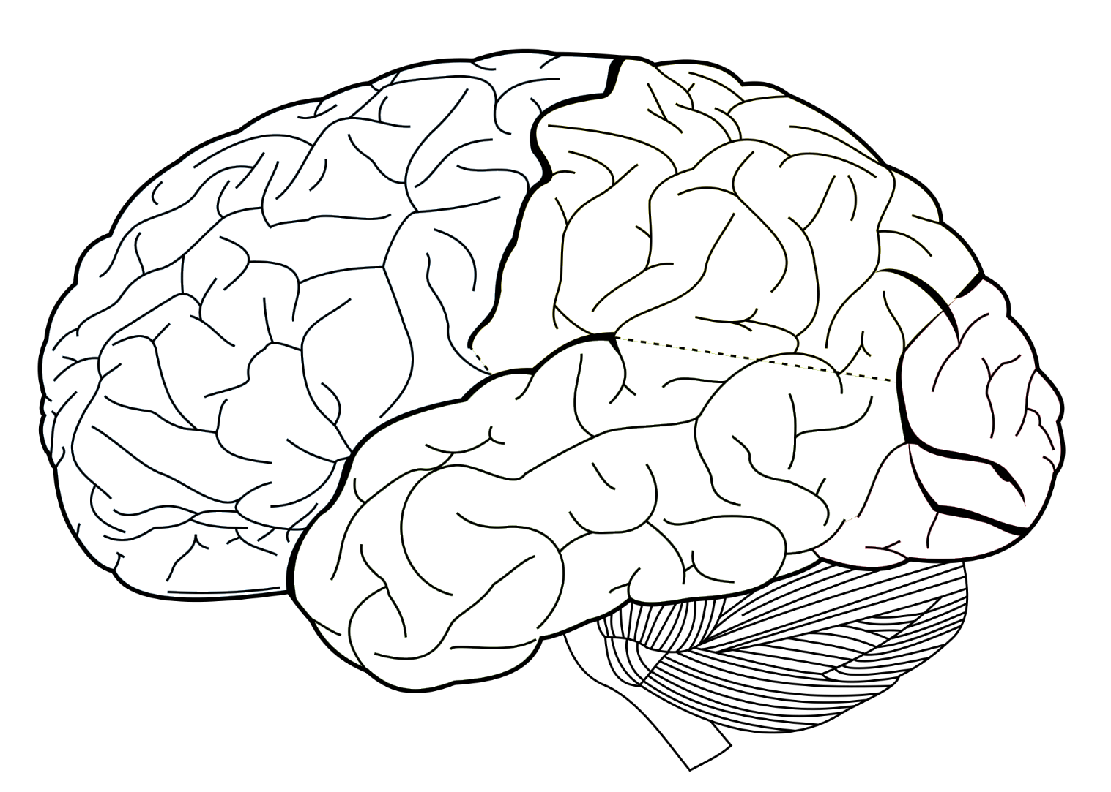
Focus of SensorPack
Notes:
Motioncapture
Goal for motioncapture
Example image of pointcloud
What the pointcloud is
Pointcloud to heightmap
Heightmap comparison
What the heightmap will be used for
Where the heightmap comes from

Slide 6
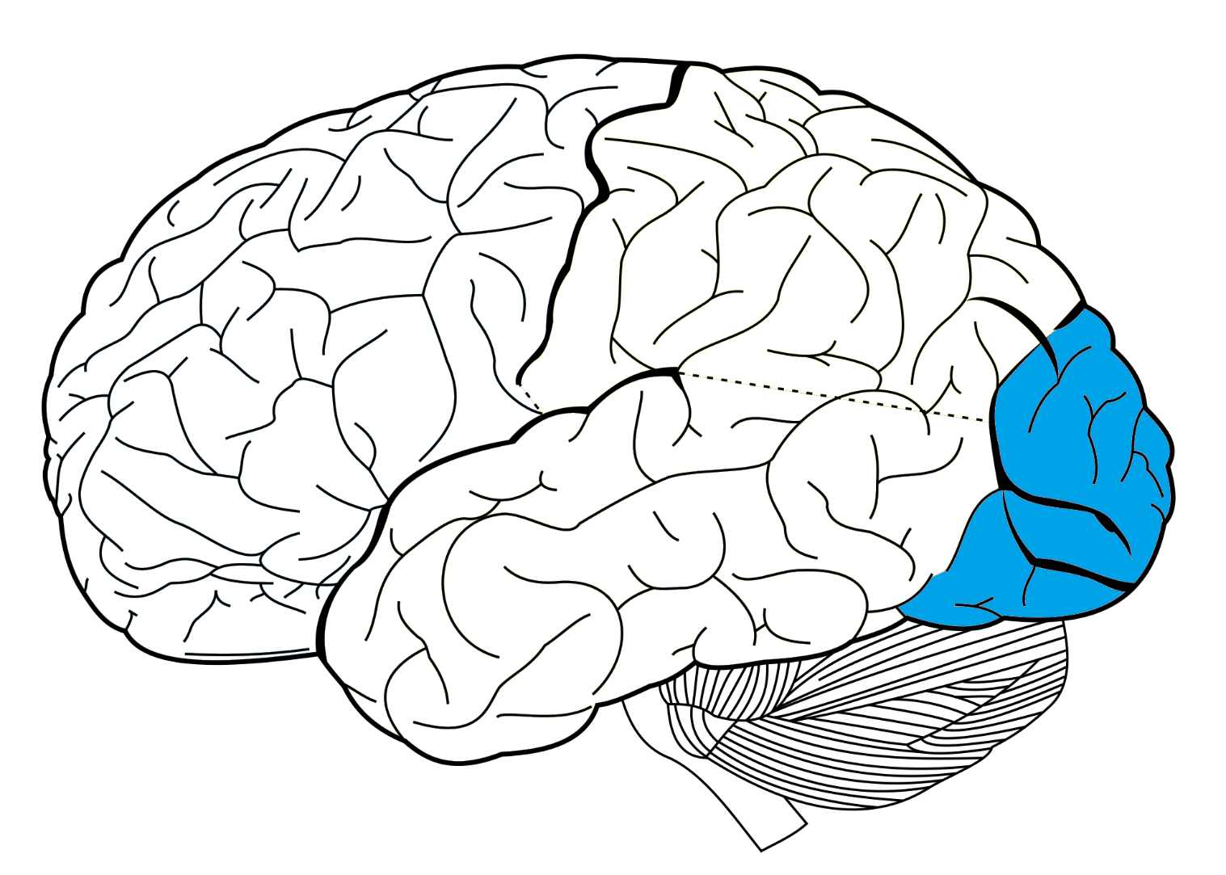
Focus of SensorPack
Occipital Lobe
(Vision)
Notes:
Motioncapture
Goal for motioncapture
Example image of pointcloud
What the pointcloud is
Pointcloud to heightmap
Heightmap comparison
What the heightmap will be used for
Where the heightmap comes from

Slide 7
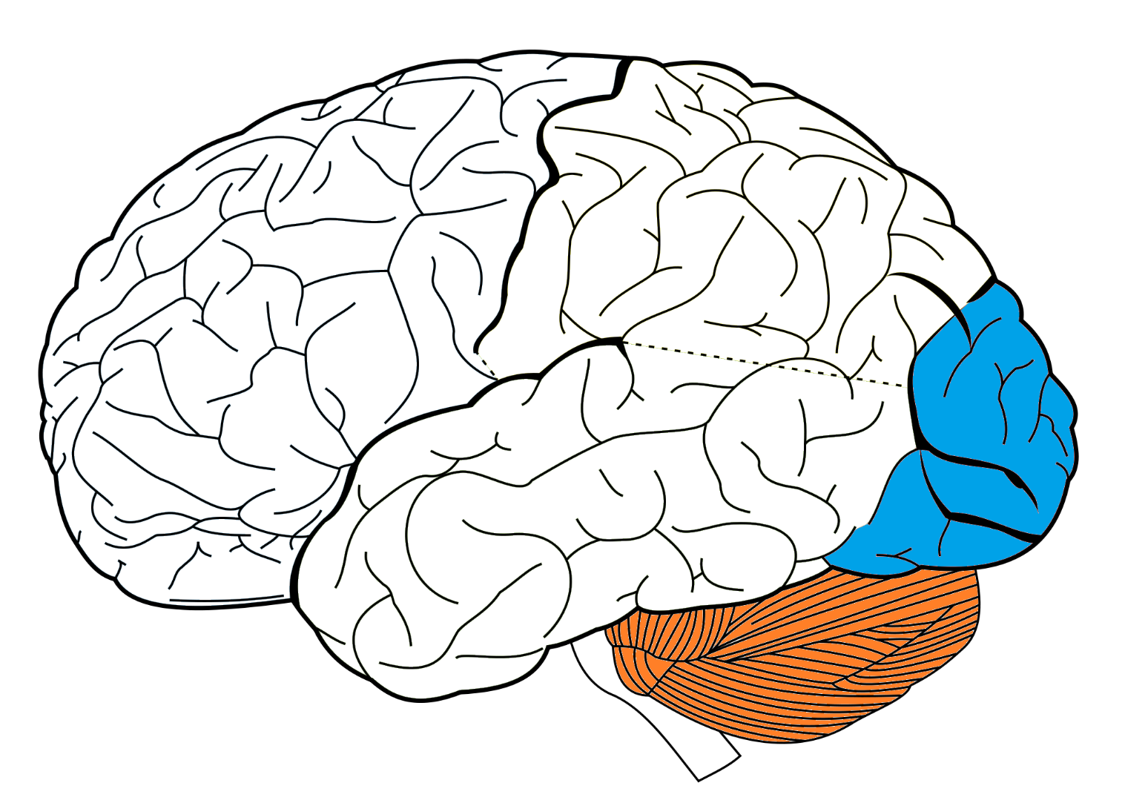
Focus of SensorPack
Occipital Lobe
(Vision)
Cerebellum/Inner Ear
(Balance & Orientation)

Slide 8
Capturing Vision
Z
Y
X
Xtion Pro Live

Slide 10
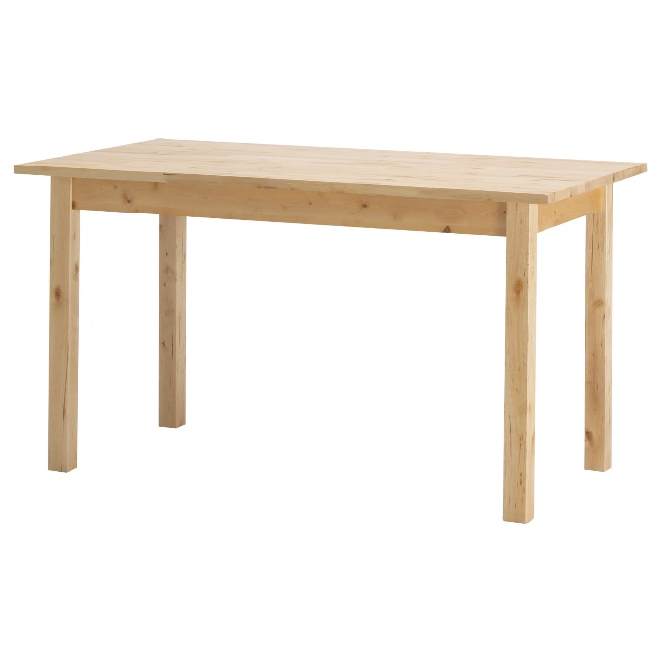
Vision without orientation

Slide 11
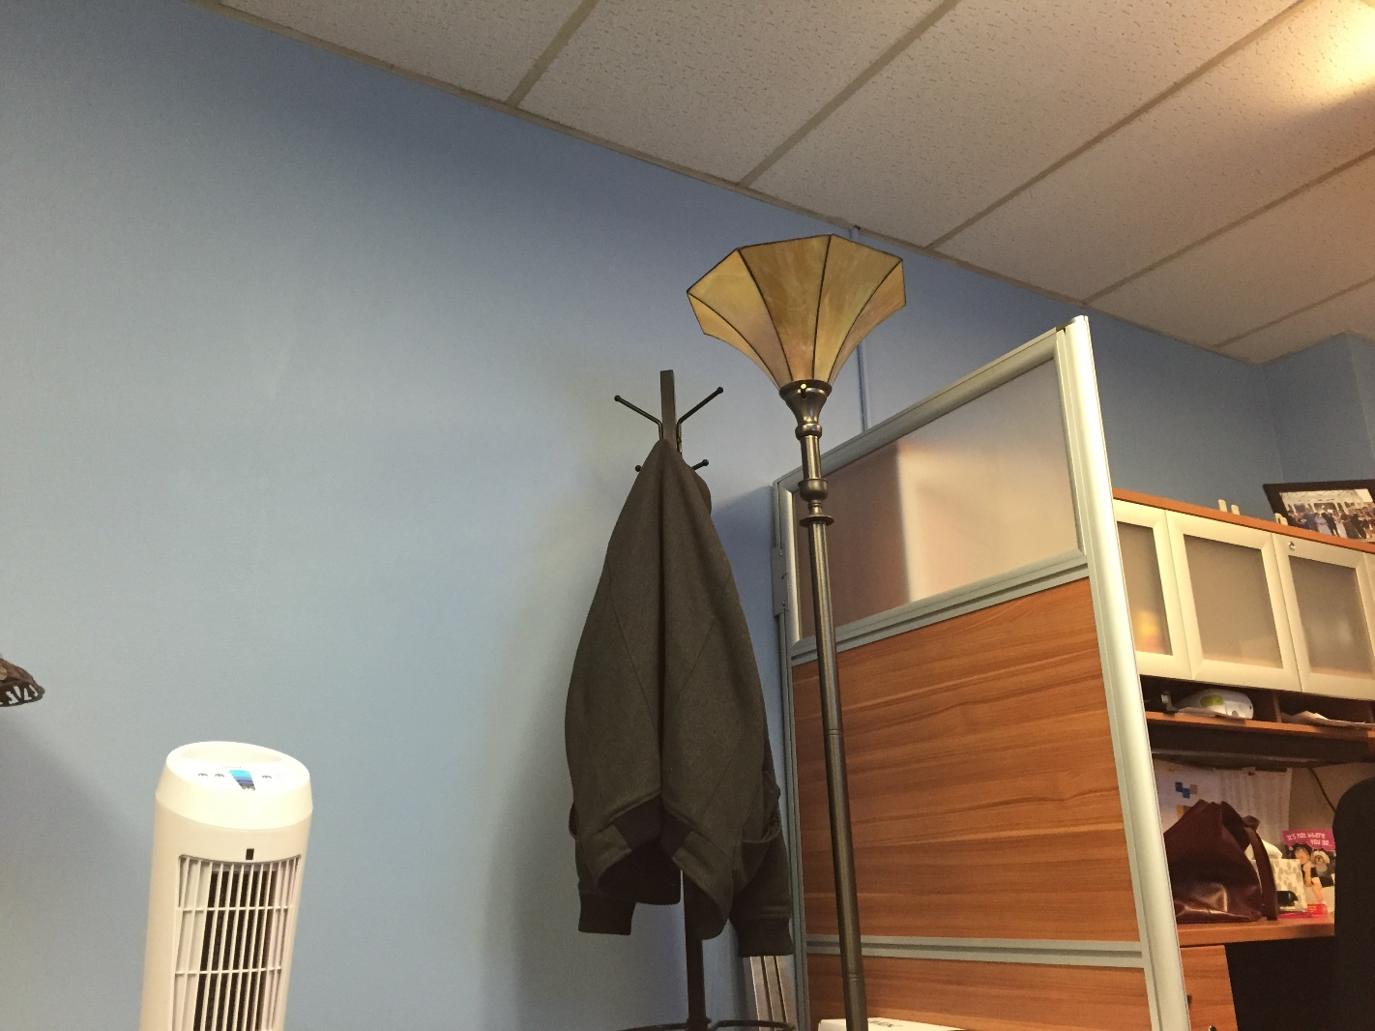

Slide 12
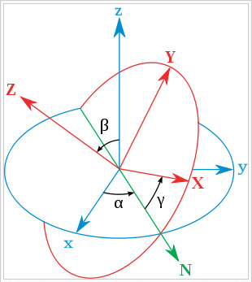
Inertial Measurement Unit (IMU)

Slide 13
Getting an accurate orientation
$$\hat{A}$$
Earth
$=g≈9.8 ms^{−1}$
Notes:
Motioncapture
Goal for motioncapture
Example image of pointcloud
What the pointcloud is
Pointcloud to heightmap
Heightmap comparison
What the heightmap will be used for
Where the heightmap comes from

Slide 14
Example of Orientation + Vision
Local Frame
Global Frame
Z
$\hat{Z}$’
New Frame = [$\hat{X}$ $\hat{Y} \hat{Z}$]
$\hat{Y}$’
Y
$\hat{X}$’
X

Slide 15
Using an oriented pointcloud, SensorPack creates a heightmap

Slide 16
Creating and using a heightmap

Slide 17
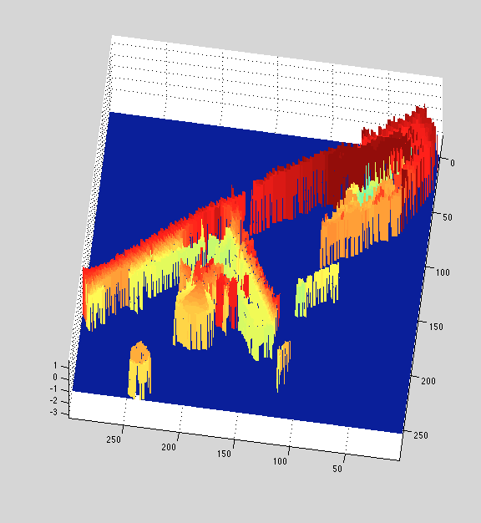

Slide 18
Using a heightmap
Robot

Slide 19
Modular structure in SensorPack makes it simple to customize

Slide 20
SensorPack Structure
Camera
Robot
Controller & Handler
Grabber

Slide 21
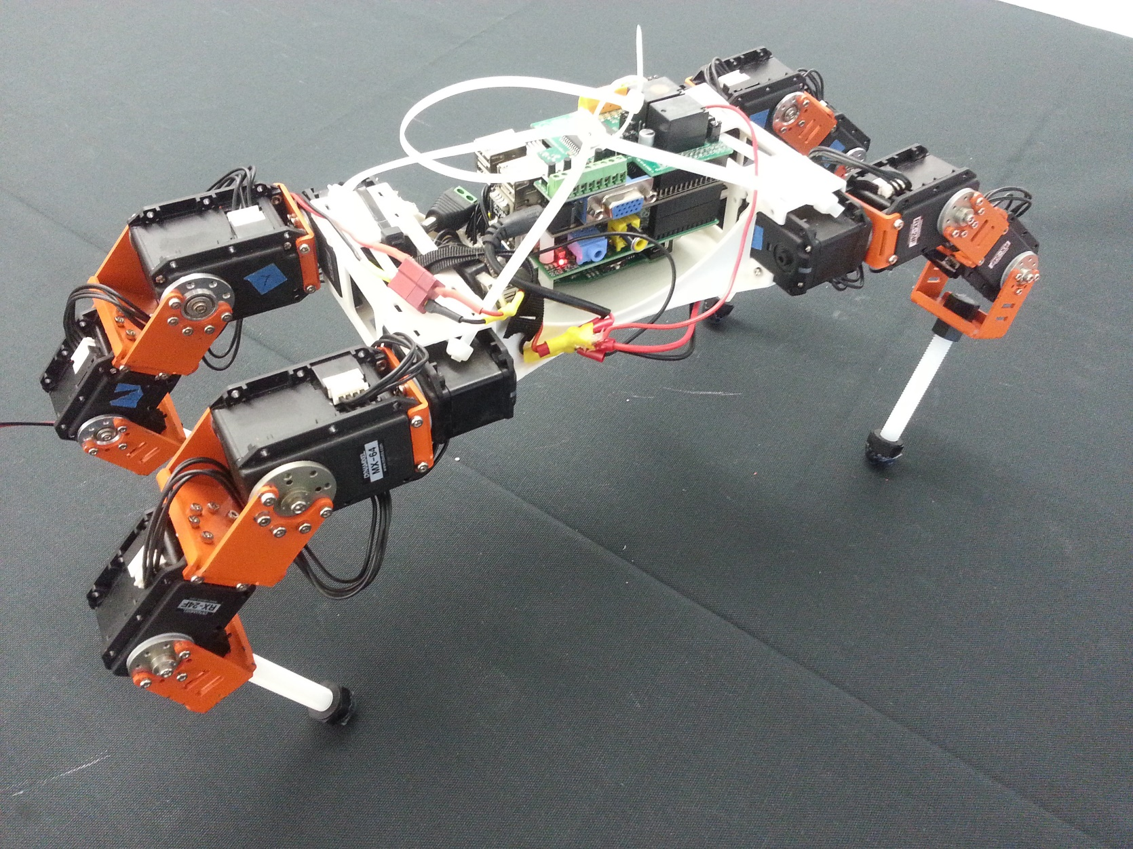
R. Links can use the SensorPack to know about its environment

Slide 22
SensorPack is a powerful tool for all researchers and hobbyists in robotics

Slide 23
SensorPack Open Source Library
Sensor Integration - Orientation Correction - Heightmap Creation

